Slide 1
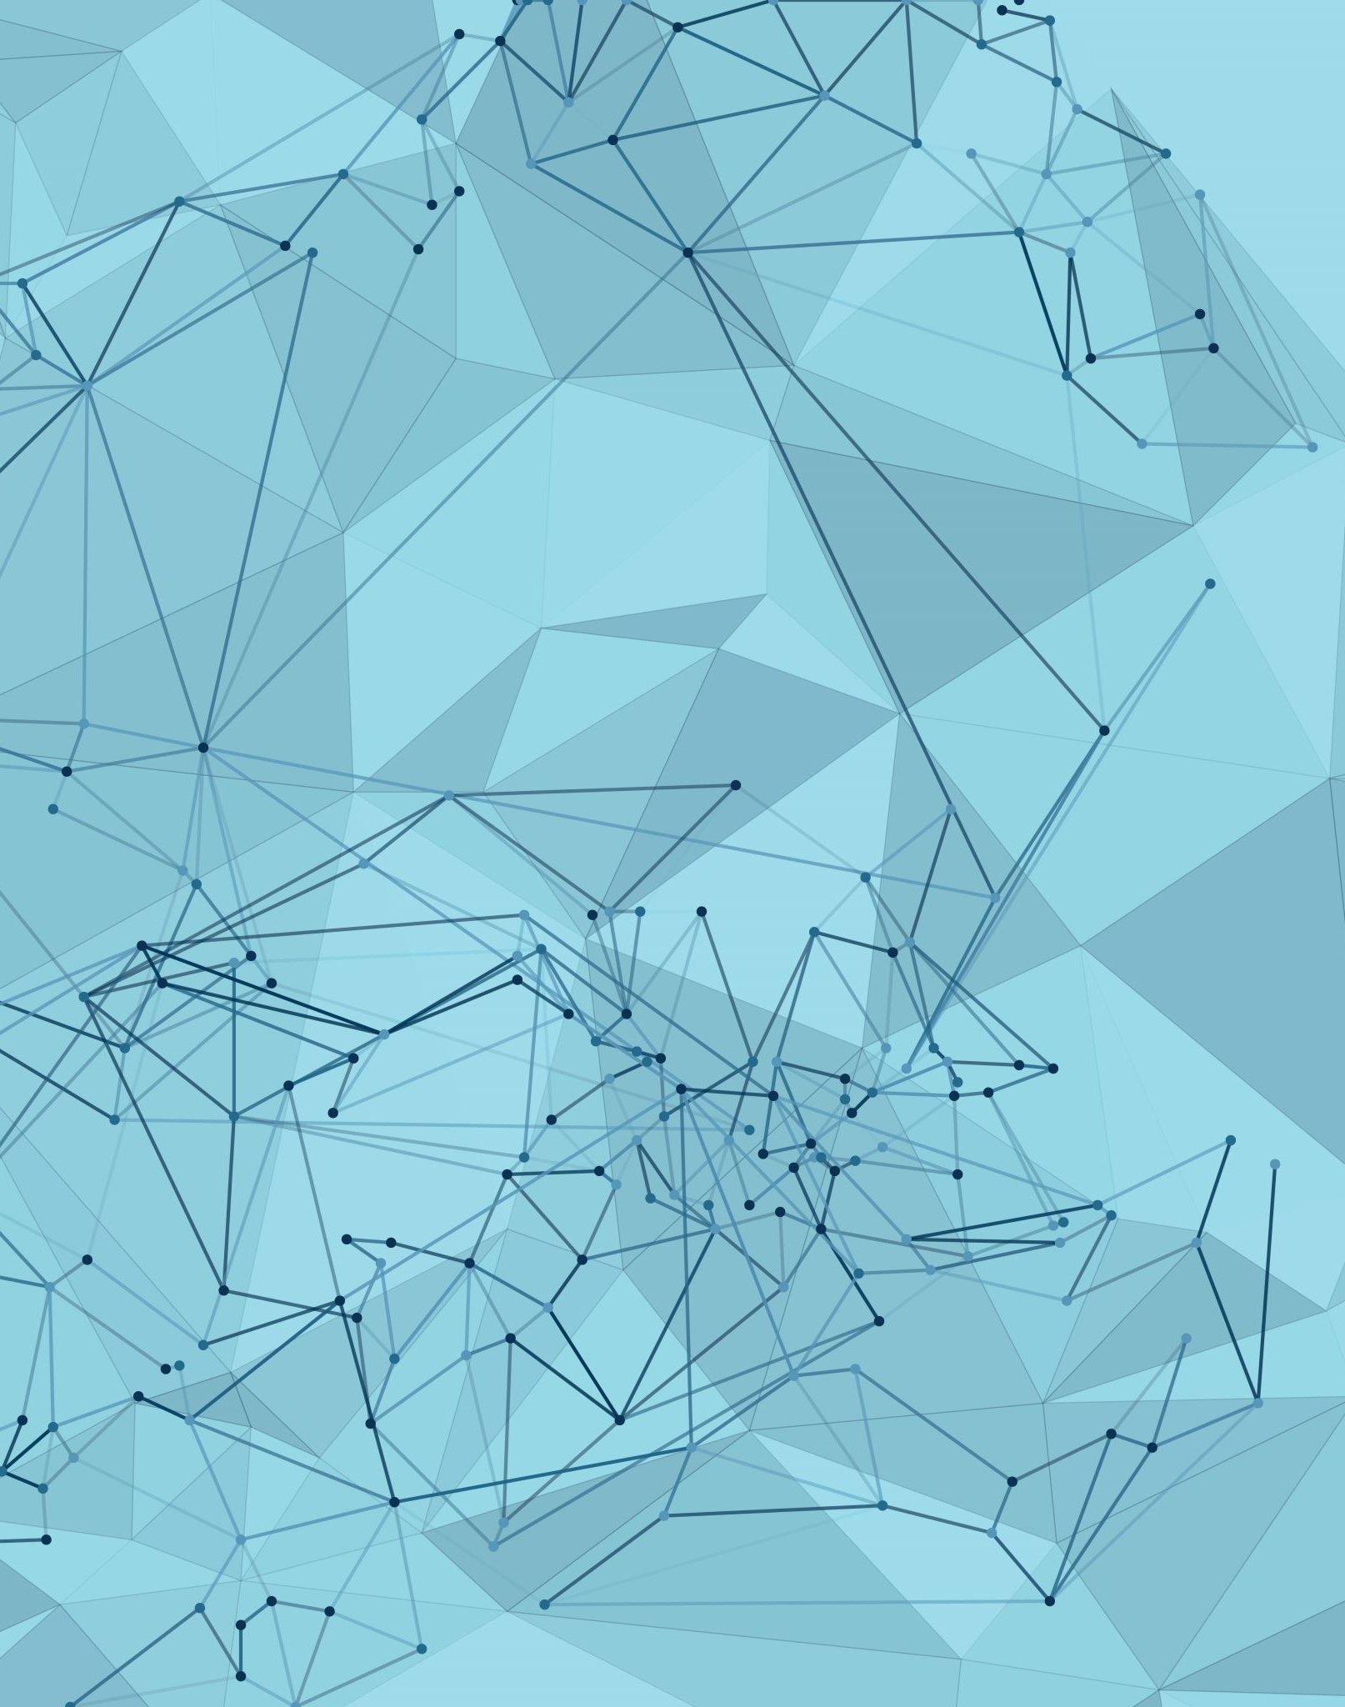
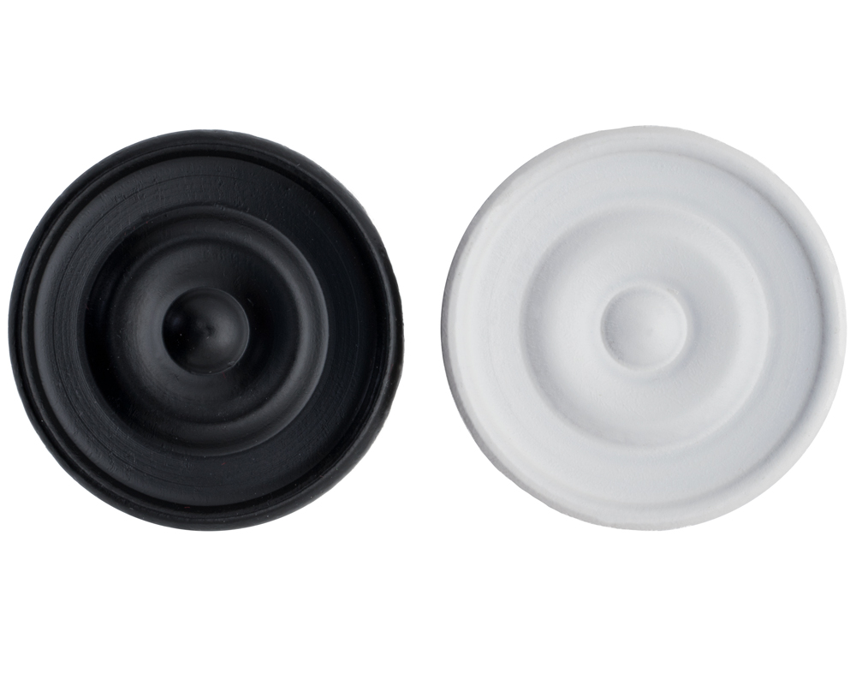
AI plays chekers
Jesus Pardo - 22202392

Slide 2
Create an AI program that can beat/draw playing Checkers other bots. The AI must learn from to play acquiring experience playing a huge quantity of simulations.
Motivation

Slide 3
The idea is using the Mini-Max algorithm to teach the AI to acquire experience and learn how to play. Mini-Max is a recursive or backtracking algorithm that provides an optimal move for the player assuming that opponent is also playing optimally. Movements generate the minimum benefit for the opponent while its benefit is maximized. The minimax algorithm performs a depth-first search algorithm for the exploration of the complete game tree and it proceeds all the way down to the terminal node of the tree with optimized movements.
Method

